Slide 1


Quantum Computing: The New Revolution
The world of computing is on the verge of a revolutionary leap, a quantum leap. The era of quantum computing is dawning, promising to transform industries, solve intractable problems, and unveil a new era of technological advancement.
By PRANAY SANKAR

Slide 2
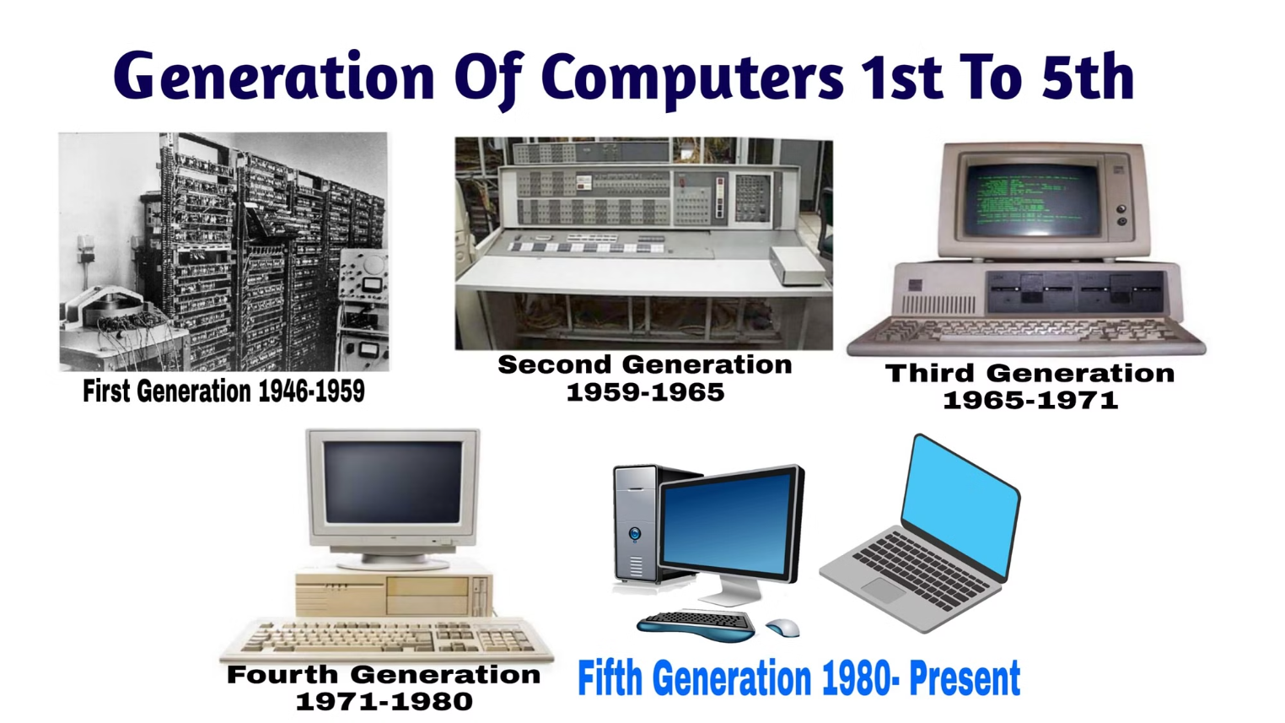

Slide 3

What is Quantum Computing?
1
Classical Computing
Uses bits representing 0 or 1, operating on a single state at a time.
2
Quantum Computing
Uses qubits, leveraging quantum mechanics to exist in multiple states (superposition) simultaneously.
3
The Result
This enables complex calculations far beyond the capabilities of classical computers.

Slide 4
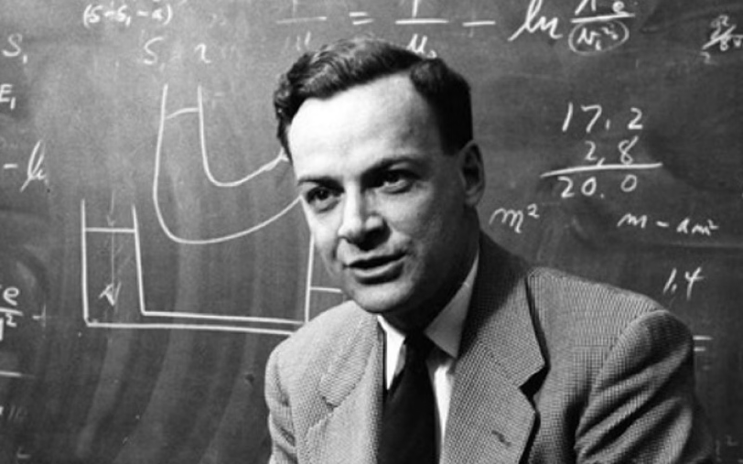
Why is Quantum Computing?
Richard Feynman
One of the founders of quantum Electrodynamics.
Atoms are the ultimate transistors.
Qubits beyond the bits (0 or 1).

Slide 5




How it is better?: Solving Problems Beyond Classical Limits
Beyond Classical Limits
Quantum computers are capable of solving problems that are beyond the reach of even the most powerful classical computers.
Exponential Advantage
The ability to process information in a fundamentally different way gives quantum computers a significant advantage, enabling them to tackle complex challenges in fields like optimization and cryptography.
Transforming Industries
This power unlocks transformative possibilities across industries, from finance and logistics to healthcare and energy.

Slide 6

Exploring the Quantum Frontier: A Glimpse into the Future
Drug Discovery
Materials Science
Climate Change
Quantum computers could revolutionize drug discovery, accelerating the development of new medicines by simulating complex molecular interactions.
Quantum simulation can unlock the secrets of materials, leading to the development of new materials with unprecedented properties.
Quantum computing can contribute to tackling climate change by simulating complex climate models and optimizing renewable energy systems.

Slide 7



Who involved in this Race?
Google
Nvidia
IBM
Quantum cryptography.
Critical quantum cryptography.
Revolutionizing cybersecurity.

Slide 8

Thank You!
We appreciate your time and interest in the possibilities of quantum computing. Let's continue the conversation and explore how this transformative technology can unlock new opportunities for your organization.

